Slide 1
Comparing the anti fingerprinting CDN
Chamara Kasun

Slide 2
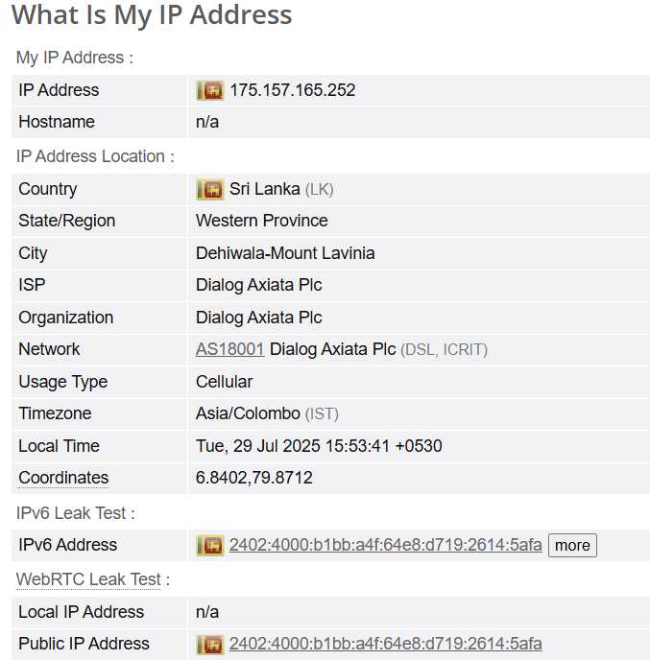
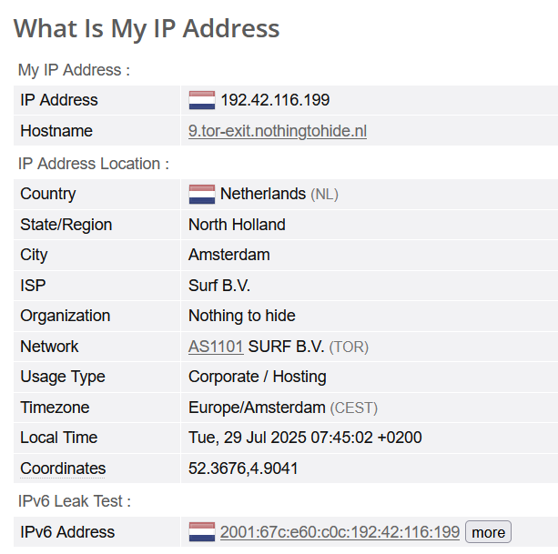
Comparison without anti fingerprinting and proposed implementation 3
Without Anti fingerprinting
WITH Anti fingerprinting

Slide 3
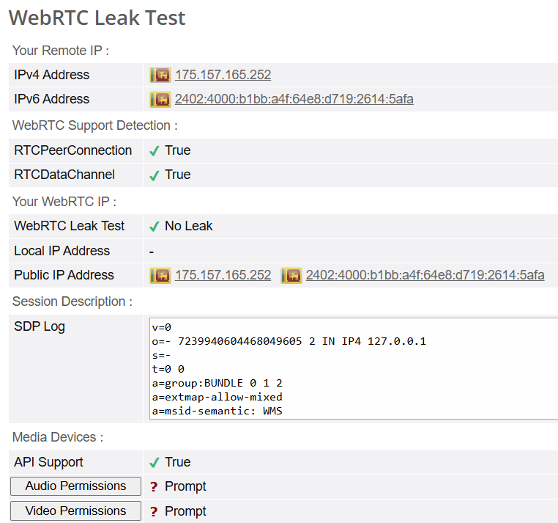
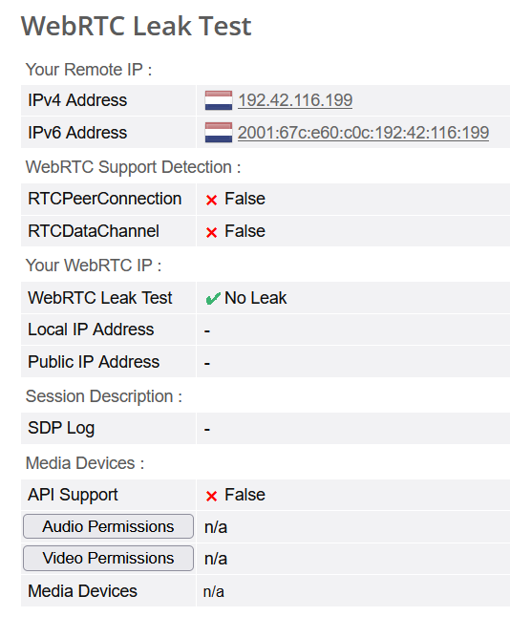
Comparison without anti fingerprinting and proposed implementation 3
Without Anti fingerprinting
WITH Anti fingerprinting

Slide 4
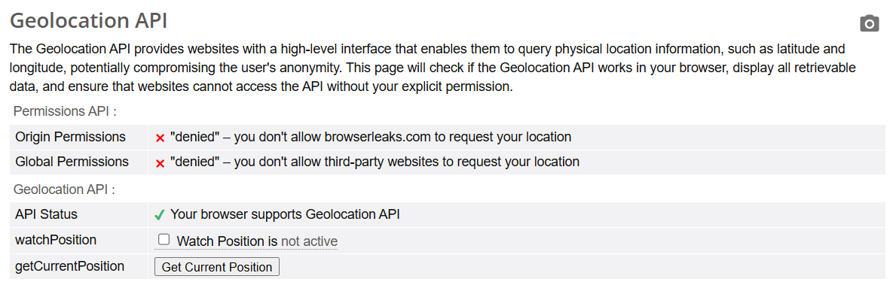
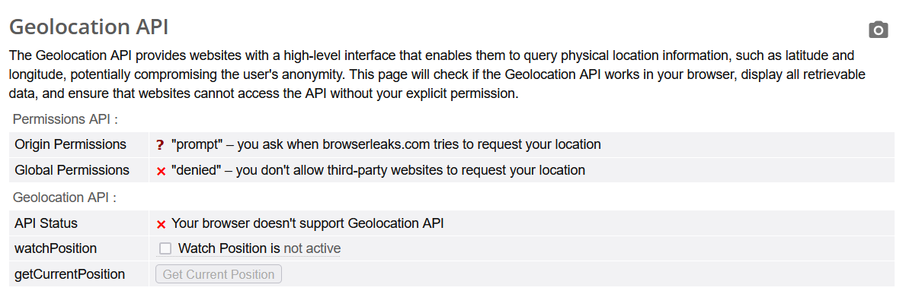
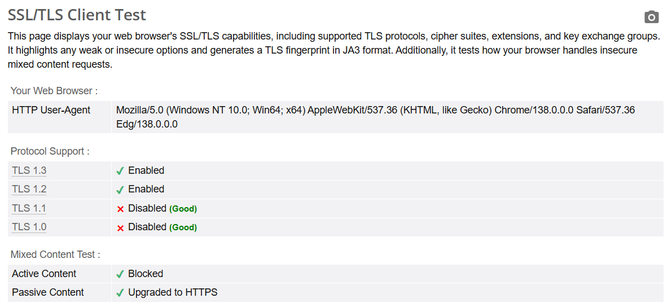
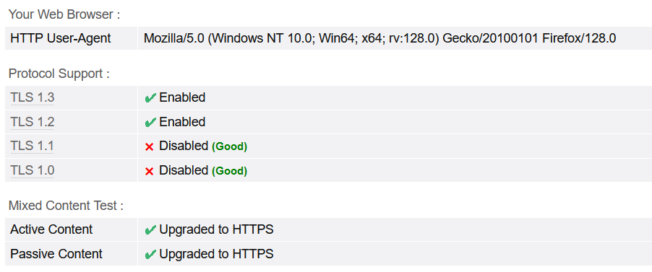
Comparison without anti fingerprinting and proposed implementation 3
Without Anti fingerprinting
WITH Anti fingerprinting

Slide 5
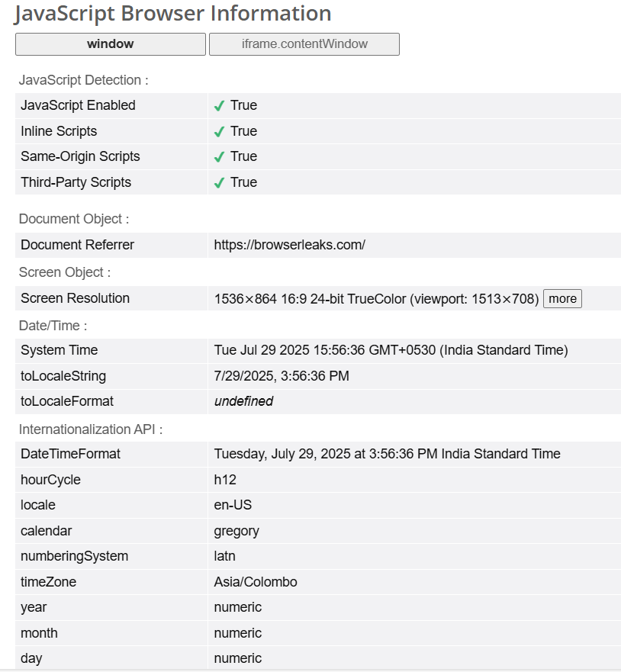
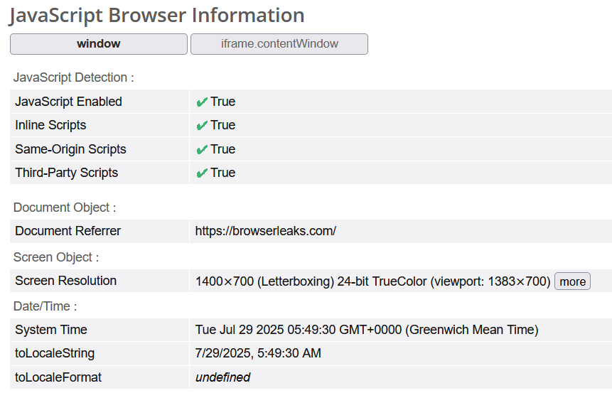
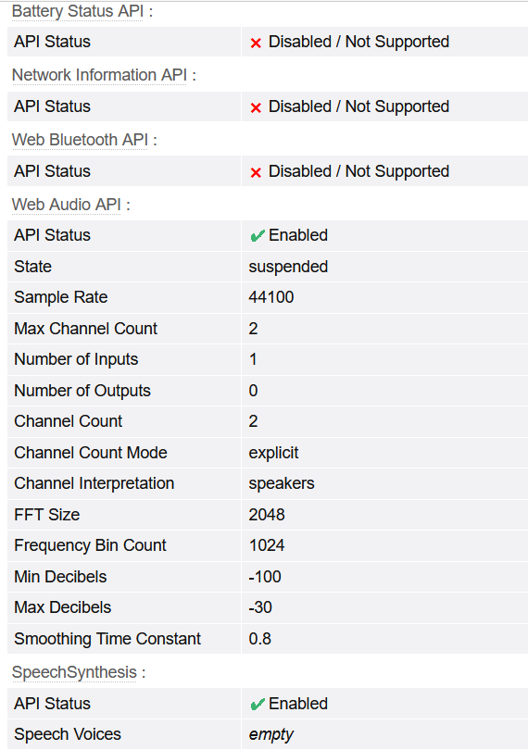
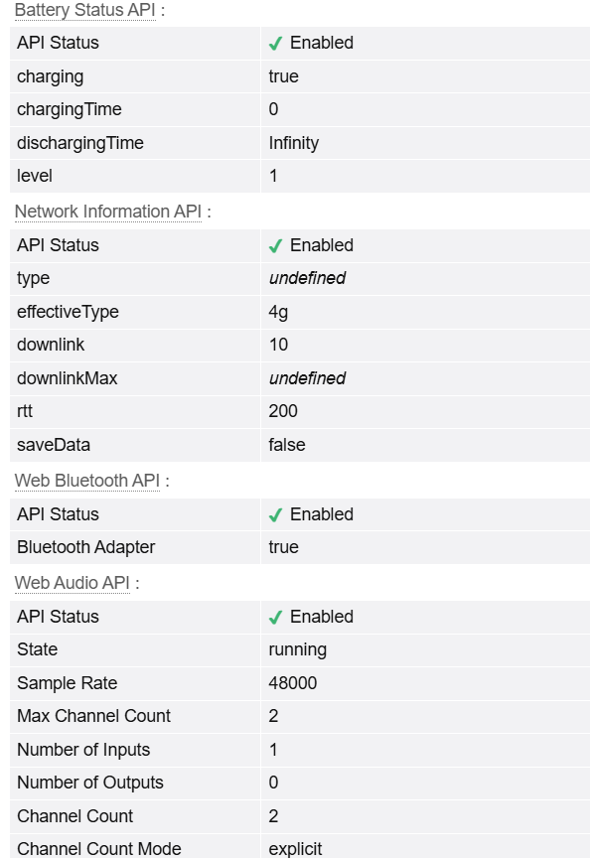
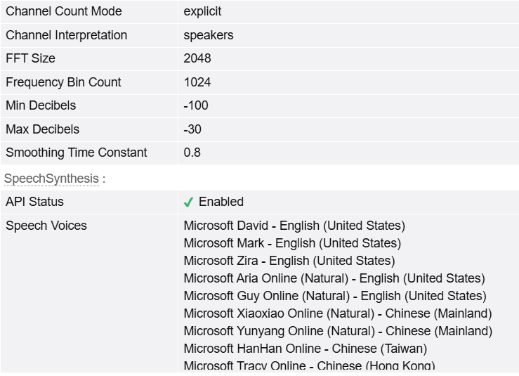
Comparison without anti fingerprinting and proposed implementation 3
Without Anti fingerprinting
WITH Anti fingerprinting

Slide 6
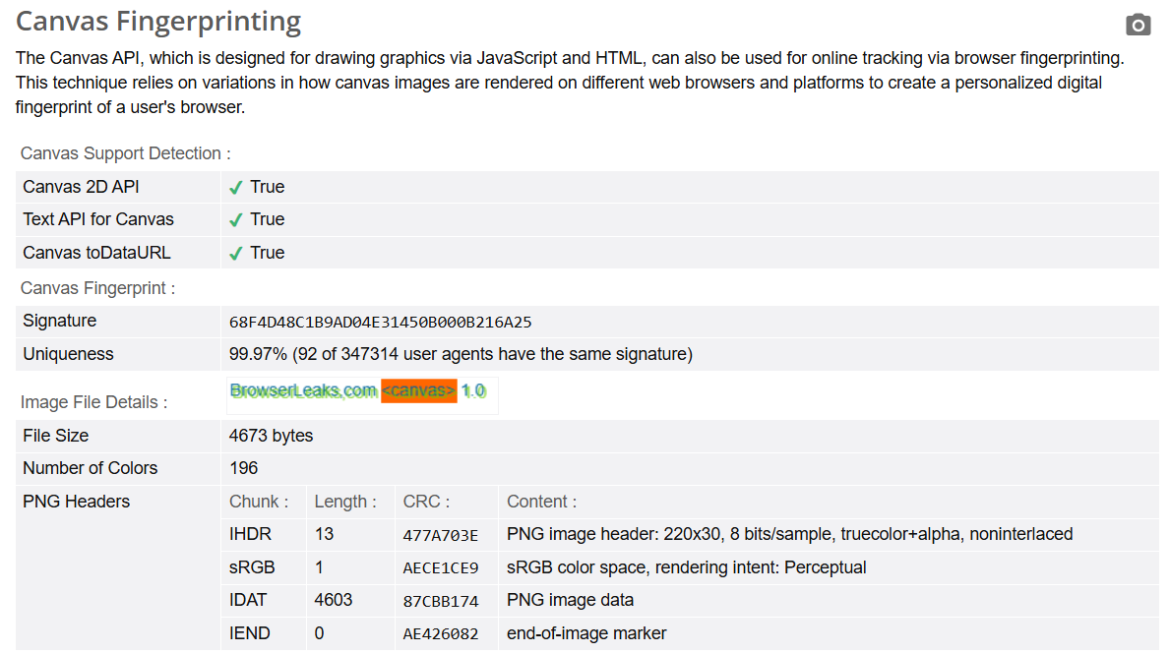
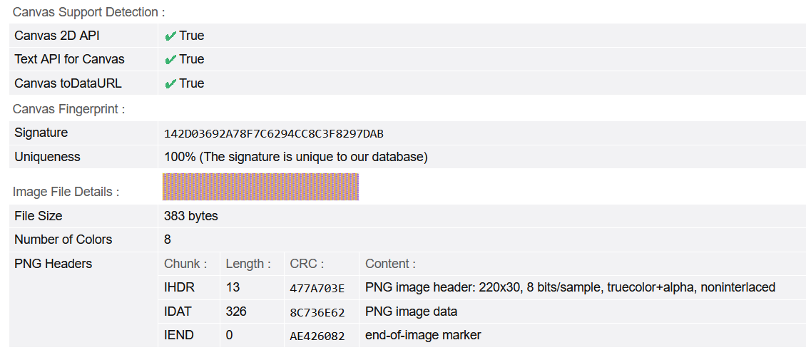
Comparison without anti fingerprinting and proposed implementation 3
Without Anti fingerprinting
WITH Anti fingerprinting

Slide 7
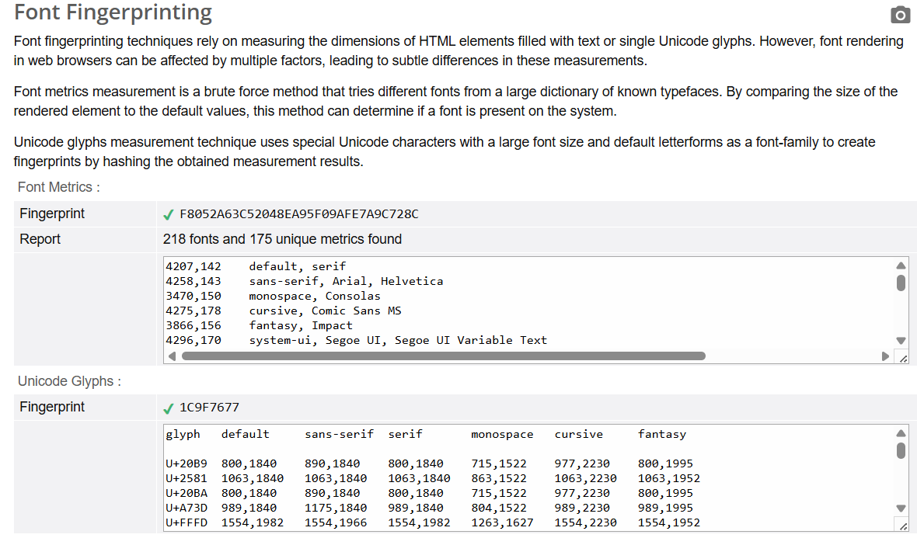
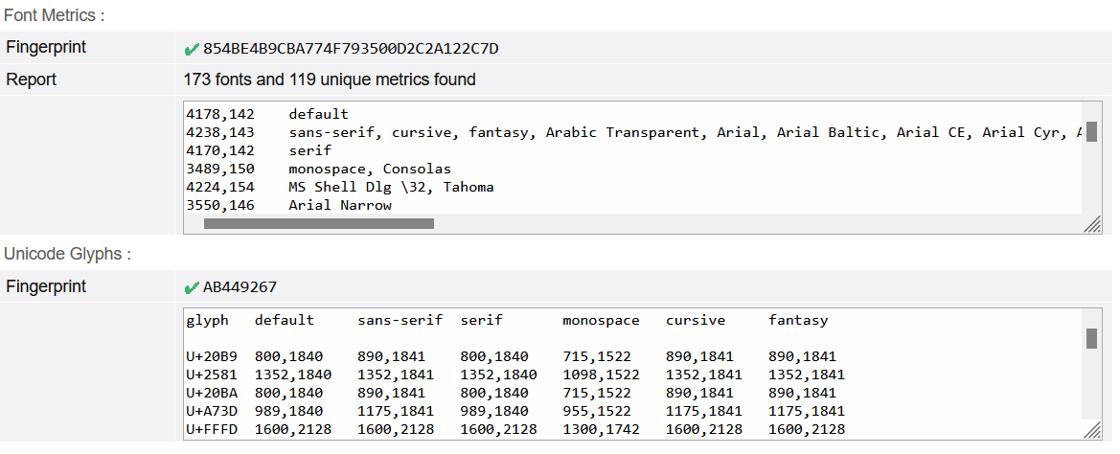
Comparison without anti fingerprinting and proposed implementation 3
Without Anti fingerprinting
WITH Anti fingerprinting

Slide 8
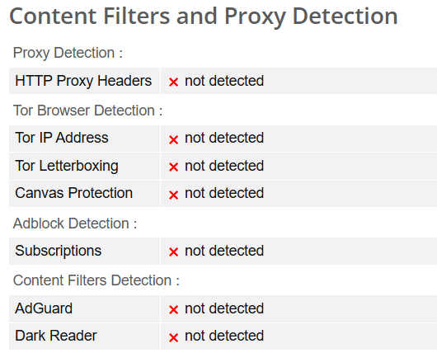
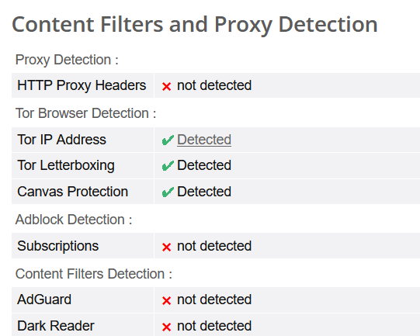
Comparison without anti fingerprinting and proposed implementation 3
Without Anti fingerprinting
WITH Anti fingerprinting

Slide 9
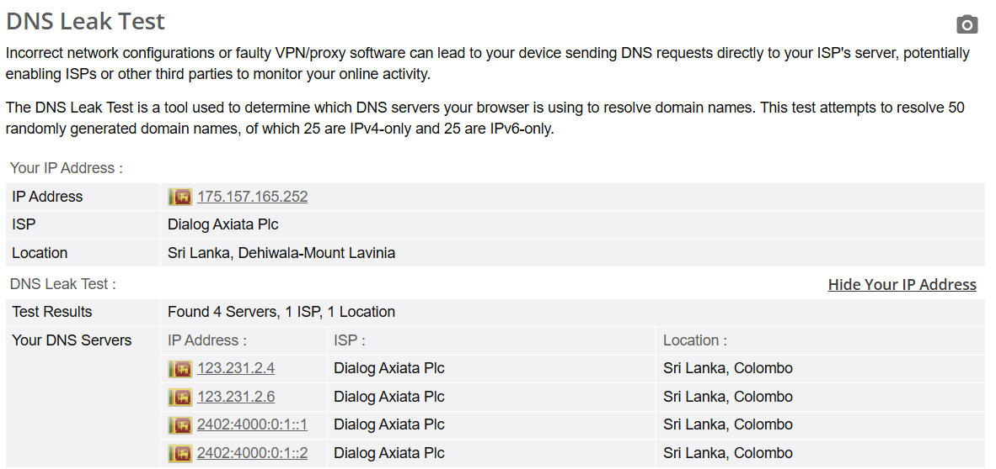
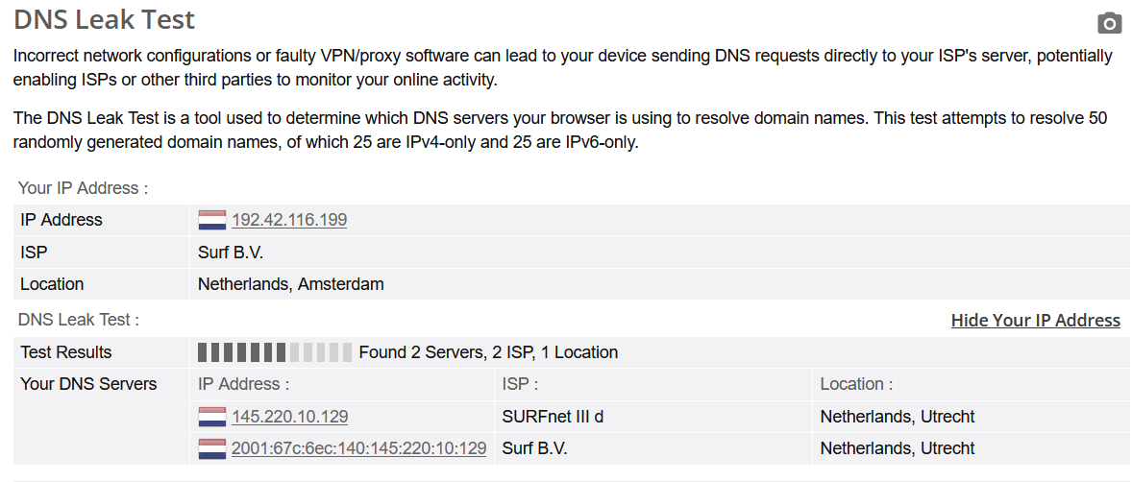
Comparison without anti fingerprinting and proposed implementation 3
Without Anti fingerprinting
WITH Anti fingerprinting

Slide 10
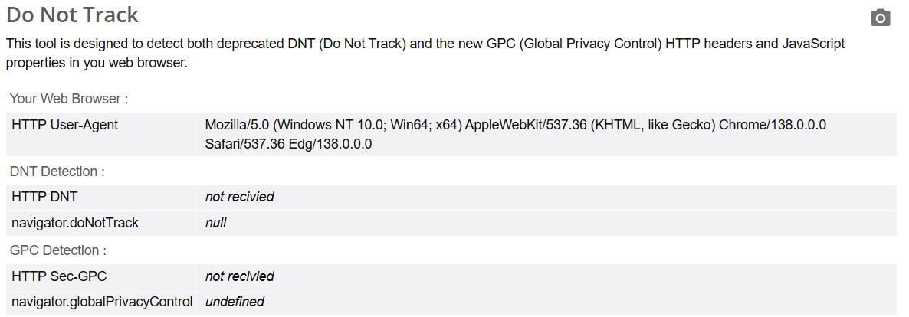
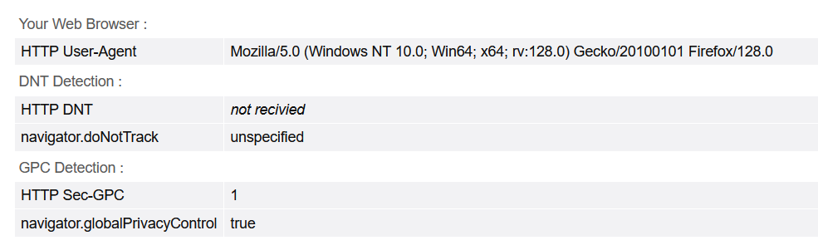
Comparison without anti fingerprinting and proposed implementation 3
Without Anti fingerprinting
WITH Anti fingerprinting

Slide 11
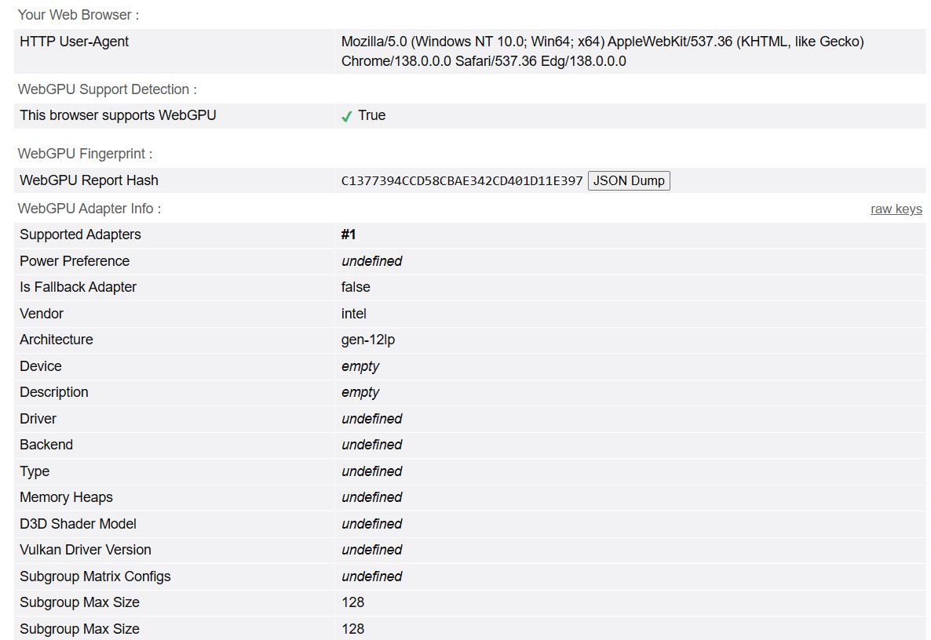
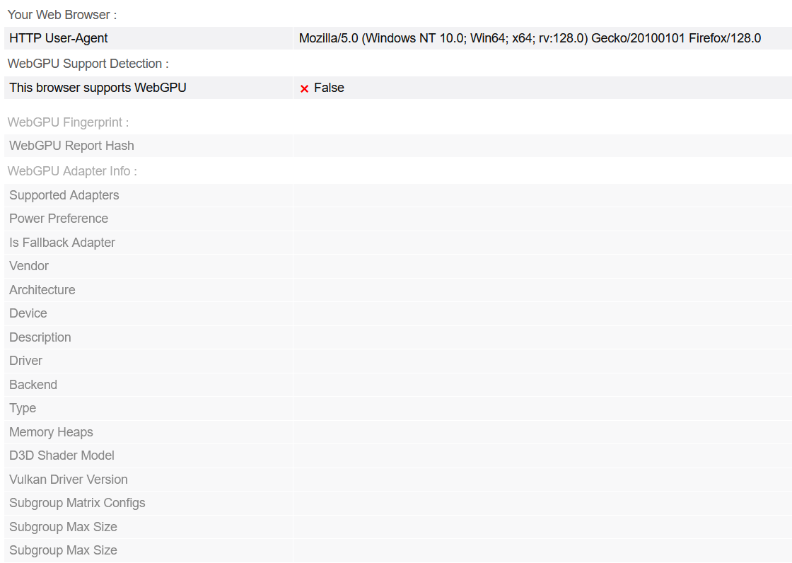
Comparison without anti fingerprinting and proposed implementation 3
Without Anti fingerprinting
WITH Anti fingerprinting

Slide 12
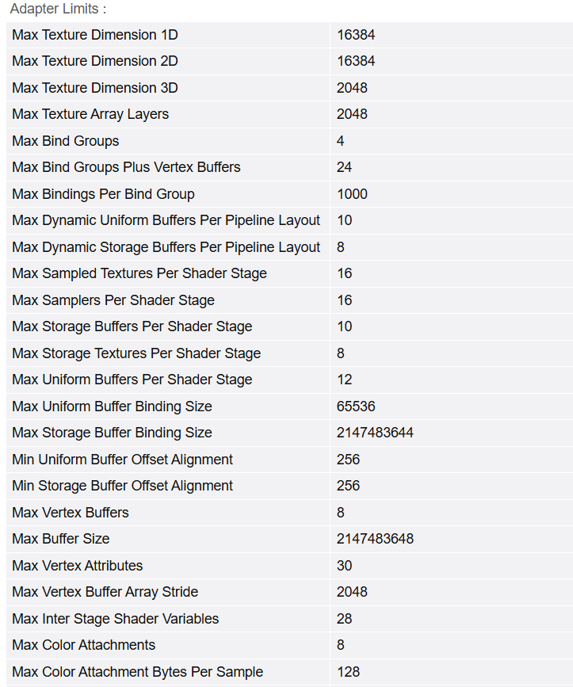
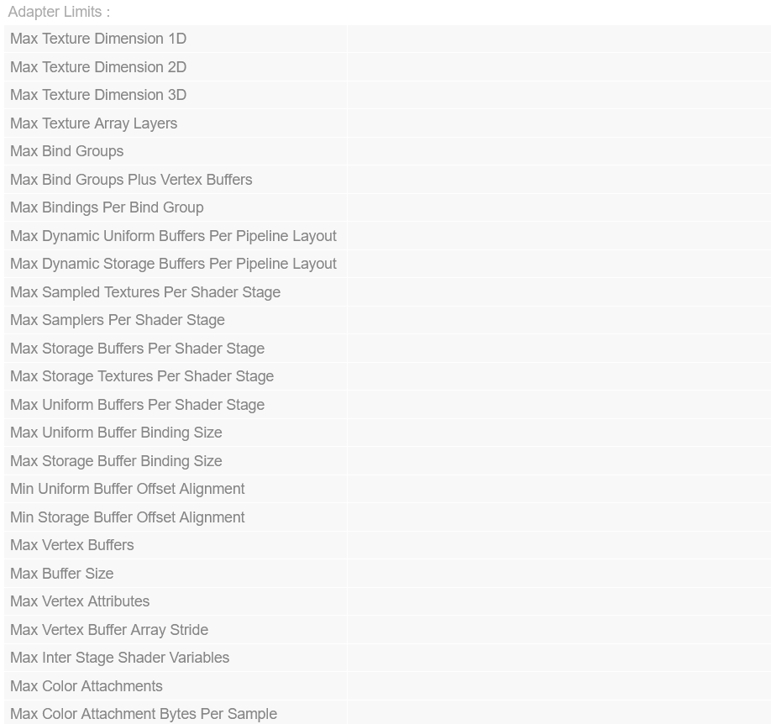
Comparison without anti fingerprinting and proposed implementation 3
Without Anti fingerprinting
WITH Anti fingerprinting

